Slide 1


CASE STUDY Of Supreme Insurance Company
By-
Rubina Shaik, Anurag Lahon, Anamika Singh

Slide 2


Presenting the Exploratory Data Analysis of the Malpractice Lawsuits of an Insurance Company.
Analysis of Data
Types of Data
Missing Data
Data Cleaning
Outliers
Factors influencing Payments
Type of attorney
Severity
Specialty
Age
Marital Status
Overview:

Slide 3


Analytical Overview:
Define Collect Organize Visualize Analyze
The data were tabulated, and the average of payment were compared with each data separately. Descriptive stats of all the columns are observed and the factors contributing to the payments are recorded.
Libraries :
read_xl, dplyr, ggplot, tidyverse, moments
Plots:
Spine plot, Histogram, Bar graphs, ggplot,Density plot, Scatterplot
Functions:
Freq(),table()

Slide 4
Payment/Private Attorney:
The average payment with private attorney is more than the average payment without private attorney by approximately $686,000
Payment/Insurance:
Private insurance has the highest payment with an average of $975,000
Payment/Severity:
64% of the total payment is attributed to severity 6 to severity 9
Payment/Severity/Age/Private Attorney:
Higher severity is found in upper age groups (40 and above) and most of the high severity cases (6-9) are carried by private attorney which leads to high payments
Payment/Specialty:
In specialty, specialties like surgery (General surgery, Orthopedic surgery, Thoracic surgery and Urological surgery) have higher payment (average payment $734)( while specialties like medicine (Emergency medicine, Internal medicine, Physical medicine, Occupational medicine) have lowest payment(average payment $595)
Major Findings

Slide 5
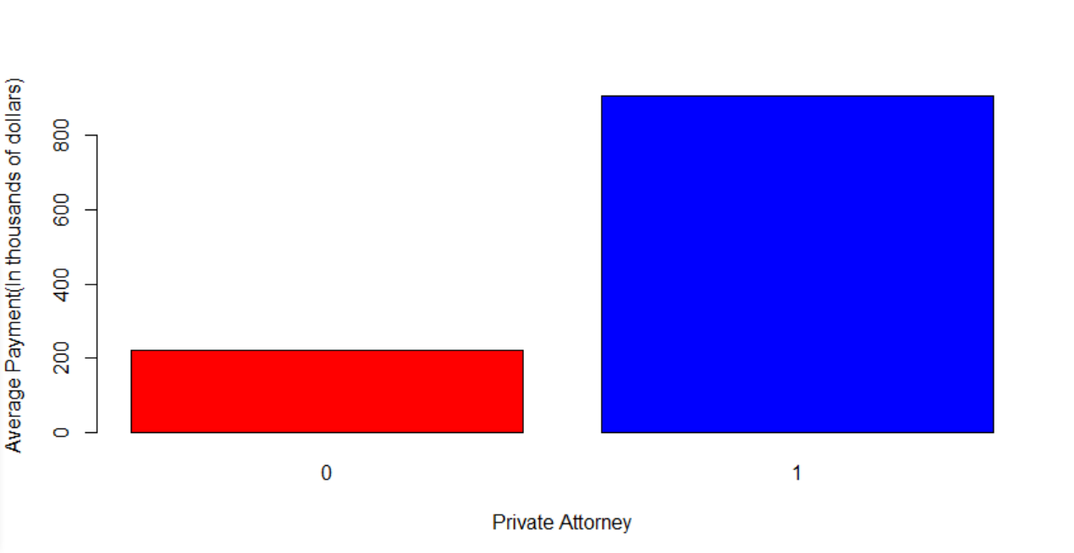
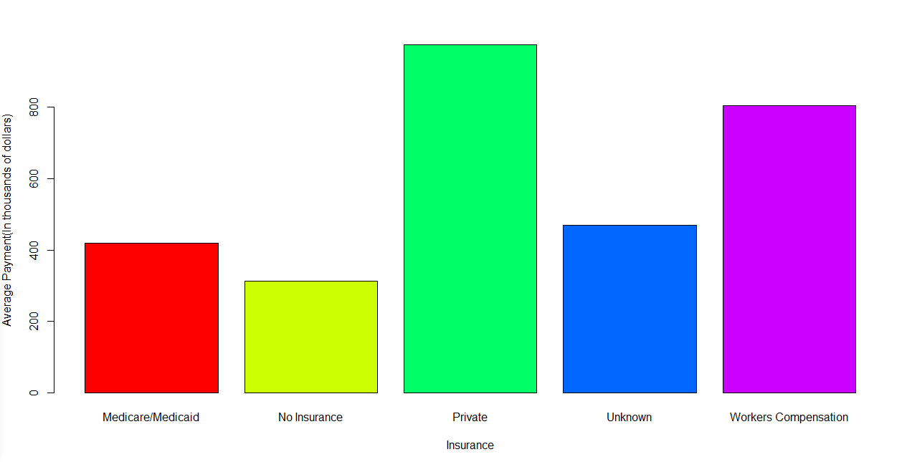
Relationship between average Payments and Private Attorney
Relationship between average Payments and Insurance

Slide 6
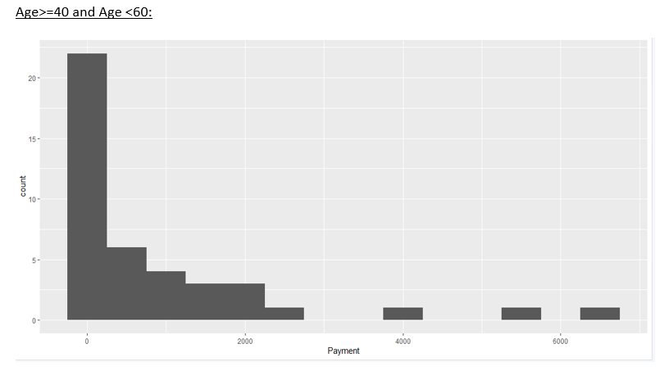
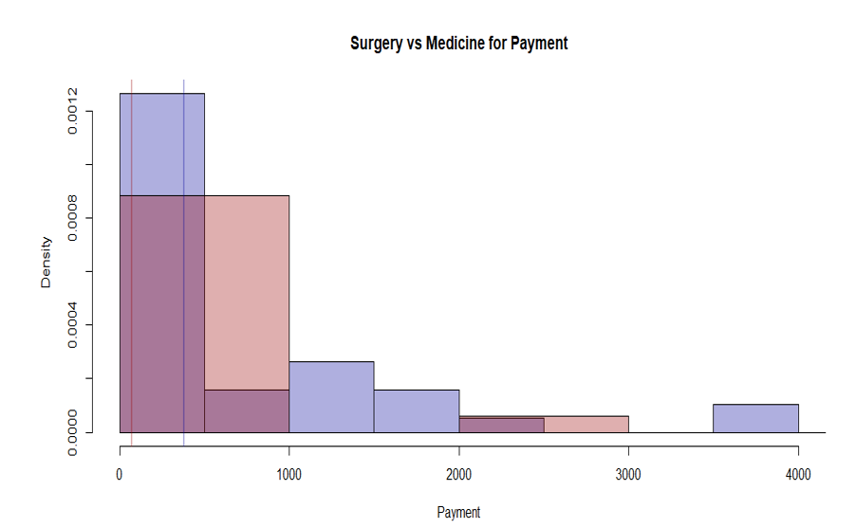
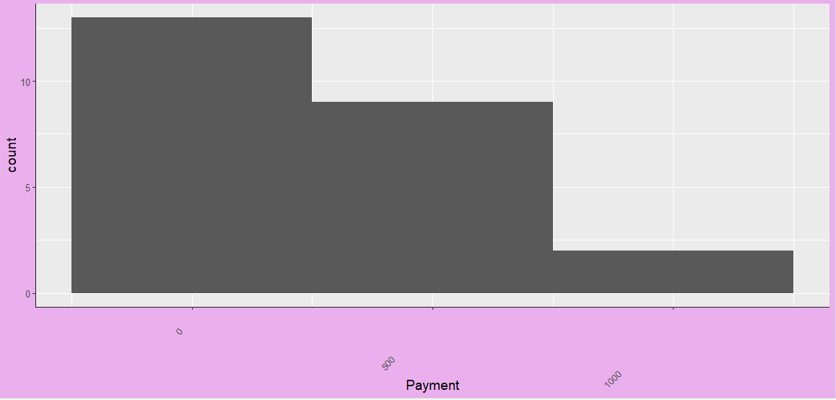
Age vs Payment
Surgery vs Medicine for Payment
Age >=60:

Slide 7

Recommendations:
Insurance company should try to settle with private attorneys to lower the payments as payments with private attorneys are much higher than without private attorney.
As payment are high for surgery, insurance company should increase the insurance cost for doctors practicing surgery.
Insurance company should try to settle with patients with severity 6-9 and for lower payments.

Slide 8
THANK YOU

